Slide 1
Data Mining for Business
Introduction to Classification and Decision Trees
Dr. Kamesam

Slide 2
Decision Trees Reading
Tan et al. textbook
Chapter 3 in.
Witten Book
Chapter 4: 4.3
Chapter 5: 5.1 to 5.6
Chapter 6 : 6.1 and 6.2

Slide 3

Data Mining / Machine Learning
Supervised Learning
Unsupervised
Learning
Classification
Regression
Clustering
Association Rules
Linear Regression
Nonlinear Regression
today

Slide 4
Terminology
Concept: thing to be learned
Learner : the ML algorithm that learns the concept
Concept description: output of learning scheme
Instances: the individual examples of a concept . Also known as Exemplars, Tuples
Attributes: measuring aspects of an instance
Our focus on nominal and numeric attributes
predictors, independent variables, features
Metadata : Information about the data that encodes background knowledge
An overview paper
https://homes.cs.washington.edu/~pedrod/papers/cacm12.pdf

Slide 5
Traditional Programming
Building a Classifier (Supervised Learning)
Data
Computer
Output
Program
Data
Learner
(ML algorithm)
Classifier
(model)
Output

Slide 6

Training and testing a Model
Test data
Training data
LEARNER
ML algorithm
Classifier
Deploy!
Evaluation results
Source: Ian Witten
Notes:
70 training 30 test
50/50

Slide 7

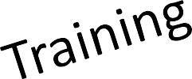
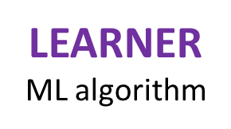
Training and testing a Model
Test data
Training data
Classifier
Deploy!
Assumption: training and test sets produced by independent random sampling from an infinite population
Model Evaluation
Source: Ian Witten

Slide 8
Problem 1
Examples of class A
Examples of class B
3 4
5 2.5
1.5 5
5 2
6 8
8 3
2.5 5
4.5 3

Slide 9


Problem 1
What class is this object?
Examples of class A
Examples of class B
3 4
5 2.5
8 1.5
1.5 5
5 2
What about this one, A or B?
6 8
8 3
2.5 5
4.5 3
4.5 7

Slide 10

Problem 1
This is a B!
Examples of class A
Examples of class B
3 4
5 2.5
8 1.5
1.5 5
5 2
Here is the rule.
If the left bar is smaller than the right bar, it is an A, otherwise it is a B.
6 8
8 3
2.5 5
4.5 3

Slide 11
Problem 1
This is a A!
Examples of class A
Examples of class B
3 4
5 2.5
4.5 7
1.5 5
5 2
6 8
8 3
2.5 5
4.5 3

Slide 12


Problem 2
Oh! This ones hard!
Examples of class A
Examples of class B
4 4
5 2.5
8 1.5
5 5
2 5
Even I know this one
6 6
5 3
3 3
2.5 3
7 7

Slide 13

Problem 2
Examples of class A
Examples of class B
The rule is as follows, if the two bars are equal sizes, it is an A. Otherwise it is a B.
4 4
5 2.5
5 5
2 5
So this one is an A.
6 6
5 3
3 3
2.5 3
7 7

Slide 14

Problem 3
100
90
80
Examples of class A
Examples of class B
70
60
Left Bar
50
40
30
4 4
5 6
20
10
10
20
30
40
50
60
70
80
90
100
1 5
7 5
Right Bar
The rule again:
if the square of the sum of the two bars is less than or equal to 100, it is an A. Otherwise it is a B.
6 3
4 8
3 7
7 7

Slide 15
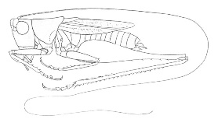
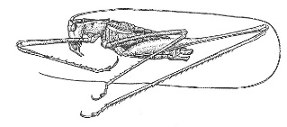
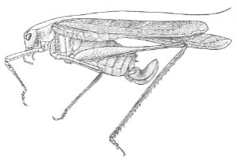
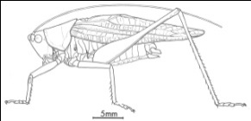
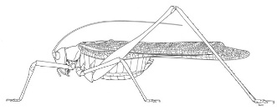
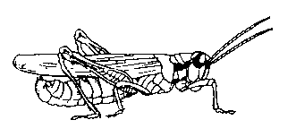
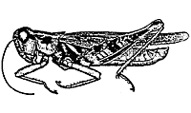
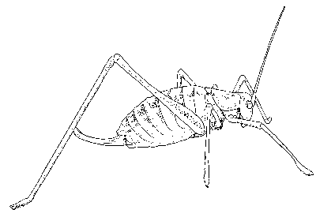
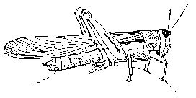
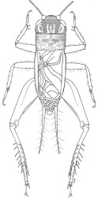
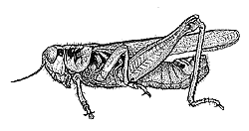
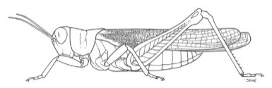
The Classification Problem
(informal definition)
Katydids
Given a collection of labeled data. In this case 5 instances of Katydids and 5 instances of Grasshoppers, decide what type of insect a new instance (the unlabeled) is.
Grasshoppers
Katydid or Grasshopper?

Slide 16
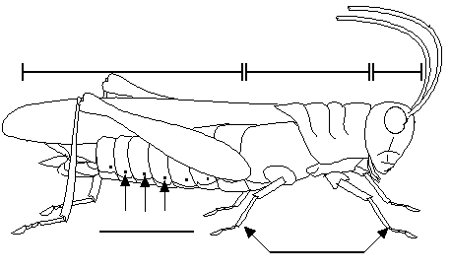
Feature Selection
Which Features would help classify ?
Color {Green, Brown, Gray, Other} ?
Has Wings?
Abdomen
Length
Thorax Length
Antennae
Length
Mandible
Size
Spiracle
Diameter
Leg Length

Slide 17
We can store features in a database or file.
My_Collection
Insect ID | Abdomen Length | Antennae Length | Insect Class
1 | 2.7 | 5.5 | Grasshopper
2 | 8.0 | 9.1 | Katydid
3 | 0.9 | 4.7 | Grasshopper
4 | 1.1 | 3.1 | Grasshopper
5 | 5.4 | 8.5 | Katydid
6 | 2.9 | 1.9 | Grasshopper
7 | 6.1 | 6.6 | Katydid
8 | 0.5 | 1.0 | Grasshopper
9 | 8.3 | 6.6 | Katydid
10 | 8.1 | 4.7 | Katydid
The classification problem can now be expressed as:
Given a training data (My_Collection), predict the class label of a previously unseen instance
previously unseen instance =
11 | 5.1 | 7.0 | ??????

Slide 18


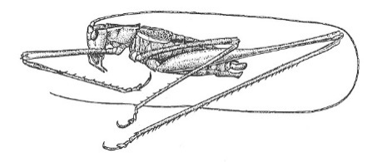
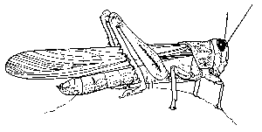
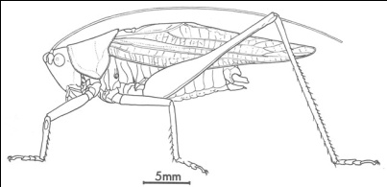
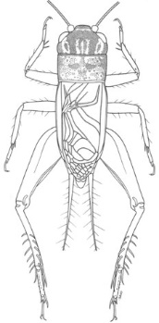
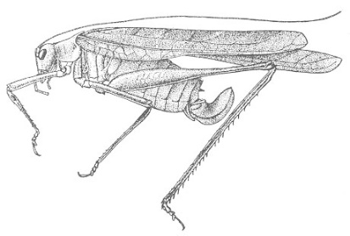


Grasshoppers
Katydids
10
9
8
7
6
Antenna Length
5
4
3
2
1
1
2
3
4
5
6
7
8
9
10
Abdomen Length

Slide 19
Grasshoppers
Katydids
10
9
8
7
6
Antenna Length
5
4
3
2
1
1
2
3
4
5
6
7
8
9
10
Abdomen Length

Slide 20
previously unseen instance =
11 | 5.1 | 7.0 | ??????
We can “project” the previously unseen instance into the same space as the database.
We have now abstracted away the details of our particular problem. It will be much easier to talk about points in space.
10
9
8
7
6
Antenna Length
5
4
3
2
1
1
2
3
4
5
6
7
8
9
10
Katydids
Grasshoppers
Abdomen Length

Slide 21
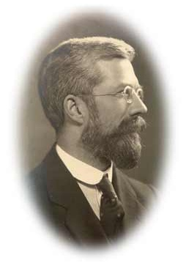
Simple Linear Classifier
10
9
8
7
R.A. Fisher
1890-1962
6
5
If previously unseen instance above the line
then
class is Katydid
else
class is Grasshopper
4
3
2
1
1
2
3
4
5
6
7
8
9
10
Katydids
Grasshoppers
Notes:
Bi-classifier
线性、二元

Slide 22
Why trees?
Decision trees, or classification trees, are one of the most popular data mining tools (along with linear regression, and logistic regression). They are
Easy to understand
Easy to implement
Easy to use
Computationally cheap
Almost all data mining packages include DTs
A DT can learn nonlinear separation boundaries
SPSS Modeler has 3 DT algorithms

Slide 23
Grasshoppers
Katydids
We will also use this lager dataset as a motivating example…
10
9
8
7
6
Antenna Length
5
Each of these data objects are called…
exemplars
(training) examples
instances
tuples
4
3
2
1
1
2
3
4
5
6
7
8
9
10
Abdomen Length

Slide 24
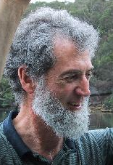
Decision Tree Classifier
( 4.3, 5.0)
10
9
8
Ross Quinlan
7
6
Antenna Length
5
Abdomen Length > 7.1?
4
3
no
yes
2
Antenna Length > 6.0?
Katydid
1
no
yes
1
2
3
4
5
6
7
8
9
10
Abdomen Length
Grasshopper
Katydid
Blue: Grasshopper
Red : Katydid

Slide 25
Definition Recap.
Decision tree is a classifier in the form of a tree structure
ROOT: top of the tree, with all the training data
Decision node: specifies a test on a single attribute
Leaf node: No more branching. classifies the target attribute
Path: a disjunction of tests to make the final decision
Decision trees classify instances (examples) by starting at the root of the tree and moving through it until a leaf node.
IMPORTANT: The usefulness of a Decision Tree (in fact, any classifier) is judged by its ability to classify unseen instances correctly (NOT the Training Data )
Notes:
Disjunction: A compound sentence in logic formed by joining two or more simple statements

Slide 26
How do we construct the
decision tree?
Basic algorithm (a greedy algorithm)
Tree is constructed in a top-down recursive divide-and-conquer
At start, all the training examples are at the root
Attributes are categorical or discrete (if continuous-valued, they are discretized in advance)
Examples are partitioned recursively based on selected attributes.
Select attribute to split on the basis of a heuristic or statistical measure (e.g., information gain)
Conditions for stopping partitioning
All samples for a given node belong to the same class
There are no remaining attributes for further partitioning – majority voting is employed for classifying the leaf
There are no samples left

Slide 27
Criterion for Splitting
Selection of an attribute to test at each node –
choose the most useful attribute for classifying examples.
But, How?
Information gain
measures how well a given attribute separates the training examples according to their target classification
This measure is used to select among the candidate attributes at each step while growing the tree
Notes:
贪婪算法 选择most useful在每一个子问题中以达到整个问题的最优化解

Slide 28




Information Gain from a split
100 Red,
100 Blue
100 Red
100 Blue
90 Red,
10 Blue
10 Red,
90 Blue
55 Red
45 Blue
45 Red
55 Blue
We prefer the split on the left to the split on the right,
because it is able to separate red and Blue much better
We will define a numeric measure (entropy)

Slide 29
Entropy
Entropy (disorder, impurity) of a set of examples, S, relative to a binary classification is:
where p₁ is the fraction of positive examples in S and p₂ is the fraction of negatives.
For multi-class problems with c categories, entropy generalizes to:
Notes:
Entropy：a measurement of disorder
P1 P2分别是事件发生的几率

Slide 30
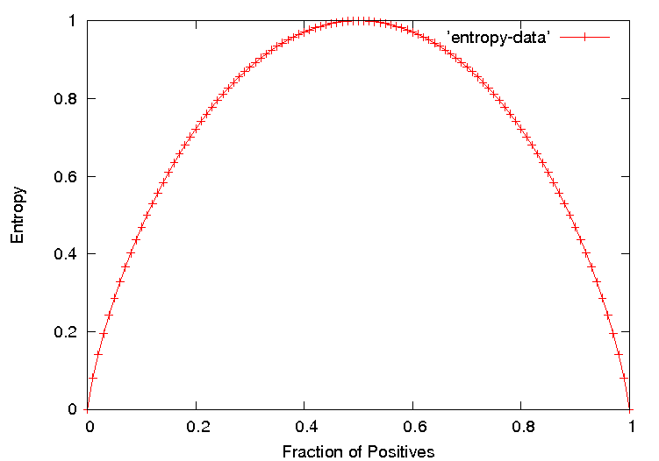
Entropy Plot for Binary Classification
The entropy is 0 if the outcome is certain.
The entropy is maximum if we have no knowledge of the system (or any outcome is equally possible).
Entropy of a 2-class problem with regard to the portion of one of the two groups
Entropy when c classes are present can be as large as log₂ c

Slide 31
Information Gain in Decision Tree Induction
Assume that using attribute A, a current set will be partitioned into some number of child sets
The encoding information that would be gained by branching on A
Gain(A) = E (Current Set) – ∑ W_{i} (E(child node))
Note: entropy is at its minimum if the collection of objects is completely uniform

Slide 32

Example 2: Developing a Decision Tree Classifier
Given data on a number of characters from the Simpsons, develop a classifier that can identify the Gender of a Simpson character

Slide 33










Person | Hair Length | Weight | Age | Class
Homer | 0” | 250 | 36 | M
Marge | 10” | 150 | 34 | F
Bart | 2” | 90 | 10 | M
Lisa | 6” | 78 | 8 | F
Maggie | 4” | 20 | 1 | F
Abe | 1” | 170 | 70 | M
Selma | 8” | 160 | 41 | F
Otto | 10” | 180 | 38 | M
Krusty | 6” | 200 | 45 | M
Comic | 8” | 290 | 38 | ?

Slide 34
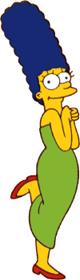


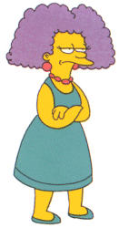
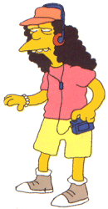
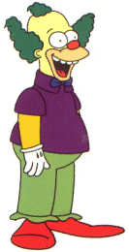


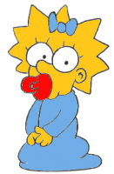
$$Entropy\left(S\right)= −p_{1}\log_{2} \left(p_{1}\right)−p_{2}\log_{2}(p_{2}$$
Entropy(4F,5M) = -(4/9)log₂(4/9) - (5/9)log₂(5/9)
= 0.9911
yes
no
Hair Length <= 5?
Let us try splitting on Hair length
(whether it is <=5)
Entropy(1F,3M) = -(1/4)log₂(1/4) - (3/4)log₂(3/4)
= 0.8113
Entropy(3F,2M) = -(3/5)log₂(3/5) - (2/5)log₂(2/5)
= 0.9710
Gain(Hair length <= 5in) = E (Current Set) – ∑ W_{i} (E(child node))
Gain(Hair Length <= 5) = 0.9911 – (4/9 * 0.8113 + 5/9 * 0.9710 ) = 0.0911

Slide 35
$$Entropy\left(S\right)= −p_{1}\log_{2} \left(p_{1}\right)−p_{2}\log_{2}(p_{2}$$
Entropy(4F,5M) = -(4/9)log₂(4/9) - (5/9)log₂(5/9)
= 0.9911
yes
no
Weight <= 160?
Let us try splitting on Weight
(whether it is <=160)
Entropy(4F,1M) = -(4/5)log₂(4/5) - (1/5)log₂(1/5)
= 0.7219
Entropy(0F,4M) = -(0/4)log₂(0/4) - (4/4)log₂(4/4)
= 0
Info. Gain(weight <= 160) = E (Current Set) – ∑ W_{i} (E(child node))
Info Gain(Weight <= 160) = 0.9911 – (5/9 * 0.7219 + 4/9 * 0 ) = 0.5900

Slide 36
$$Entropy\left(S\right)= −p_{1}\log_{2} \left(p_{1}\right)−p_{2}\log_{2}(p_{2}$$
Entropy(4F,5M) = -(4/9)log₂(4/9) - (5/9)log₂(5/9)
= 0.9911
yes
no
age <= 40?
Let us try splitting on Age
(whether it is <=40)
Entropy(3F,3M) = -(3/6)log₂(3/6) - (3/6)log₂(3/6)
= 1
Entropy(1F,2M) = -(1/3)log₂(1/3) - (2/3)log₂(2/3)
= 0.9183
Info Gain (Age <= 40) = E (Current Set) – ∑ W_{i} (E(child node))
Info Gain (Age <= 40) = 0.9911 – (6/9 * 1 + 3/9 * 0.9183 ) = 0.0183

Slide 37
Of the 3 features we had, Weight was best. But while people who weigh over 160 are perfectly classified (as males), the under 160 people are not perfectly classified… RECURSION!
yes
no
Weight <= 160?
This time we find that we can split on Hair length, and we are done!
yes
no
Hair Length <= 2?
C5.0 in SPSS Modeler uses information gain to select the best attribute at each step in growing the tree

Slide 38
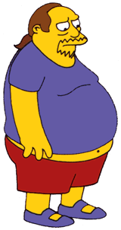
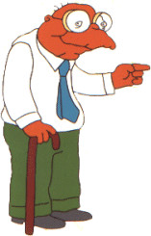

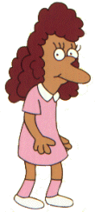
We don’t need to keep the data around, just the test conditions.
Weight <= 160?
How would these people be classified?
yes
no
Hair Length <= 2?
Male
yes
no
Male
Female
In practice, all classifiers make some mistakes in classification. Our goal is to a build classifiers that make as few errors as possible.

Slide 39
It is easy to convert a Decision Trees to a set of rules…
Weight <= 160?
yes
no
Hair Length <= 2?
Male
yes
no
Male
Female
Rules to Classify Males/Females
If Weight greater than 160, classify as Male
Elseif Hair Length less than or equal to 2, classify as Male
Else classify as Female

Slide 40
Deciding on where to split (continuous attributes)
For each feature, find the best possible split for that feature, as follows:
SPSS Modeler Algorithmic Guide:
numeric fields. Sort the field values for records in the node from smallest to largest. Choose each point in turn as a split point, and compute the impurity statistic for the resulting child nodes of the split. Select the best split point for the field as the one that yields the largest decrease in impurity relative to the impurity of the node being split.

Slide 41
Discretization and deciding on split (Continuous Attributes)
Find each feature’s best split. For each feature, find the best possible split for that field, as follows:
Weight from Simpson example. Although weight is a continuous attribute, the only values that appear in the training data are:
20, 78, 90, 150, 160, 170, 180, 200, 250
Try <= 20, >20, <= 78, >78, <= 90, >90 and so on.
Or Try <= 49, > 49, <= 84, > 84, <= 120, >= 120, and so on
Choose the split that gives the max information gain.
SPSS Modeler uses the above strategy

Slide 42
Splitting on Discrete Attributes
In the Simpsons example, all the features are continuous (Weight, Hair length, Age).
Often, the feature to split on may be discrete valued (ex: employed/unemployed, gender, color, etc.)
The DT algorithm is designed for discrete valued attributes. In the continuous case we discretize the variable. So discrete features are less work.
In the next example, all the features are discrete

Slide 43
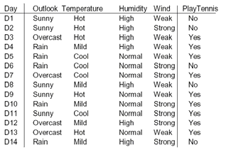
Ex: Classification with Discrete Attributes
Test
record
Sunny Hot Normal Strong ?
Outlook takes 3 values, Temperature 3, Humidity 2, and
wind 2 possible values All the Attributes are Categorical

Slide 44
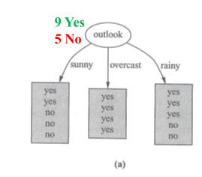
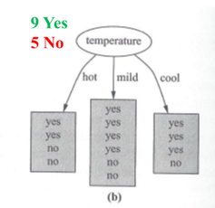
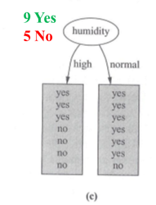
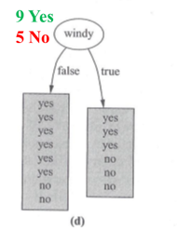
Splitting on a Discrete Attribute

Slide 45




Entropy Calculation
Split on Outlook?
0.9403
9 YES 5 NO
Sunny
Overcast
Rainy
2 YES 3 NO
4 YES 0 NO
3 YES 2 NO
0.9709
0
0.9709
Entropy after Split =
Information Gain = 0.9403 - 0.6935 = 0.2467

Slide 46


Selecting Attribute to Split
9 Yes
5 No
Information Gain
Gain(Outlook) = 0.247
Gain(Temperature) = 0.029
Gain(Humidity) = 0.152
Gain(Windy) = 0.048
All calculations in Witten textbook
pp 100-101

Slide 47
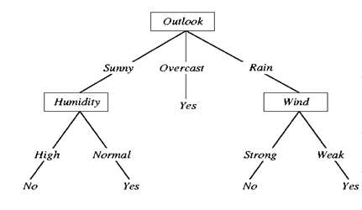
Decision Tree with Discrete attributes
(worked out example sec 4.3 of Witten book). Target: Yes, No

Slide 48
Non Binary Classification
( more than 2 classes)

Slide 49
Non Binary Classification
In practice, we may have more than two classes
The DT algorithm generalizes to any number of classes
The following datasets are on Black board
Ex1: Iris flowers (R. A. Fisher): (3 classes)
Setosa, Virginica, Versicolor
Ex2: Customer Churn Example: (3 classes)
Current, Voluntary Churn, Involuntary Churn

Slide 50
DTs in practice...
Growing to purity is bad (overfitting)
x2: sepal width
x1: petal length

Slide 51
DTs in practice...
Growing to purity is bad (overfitting)
x2: sepal width
x1: petal length

Slide 52
DTs in practice...
52
Growing to purity is bad (overfitting)
STRATEGIES
Terminate tree growth early
Grow to purity, then prune back

Slide 53
DTs in practice...
Growing to purity is bad (overfitting)
Not statistically
supportable leaf
x2: sepal width
Remove split
& merge leaves
x1: petal length
53

Slide 54
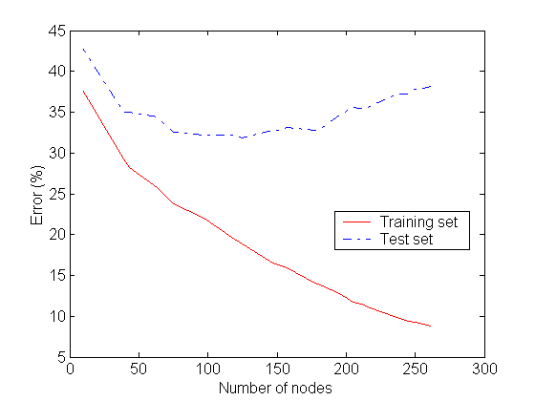
Underfitting and Overfitting
Overfitting
model complexity (the issue of overfitting is important for classification in general not only for decision trees)
Underfitting: when model is too simple, both training and test errors are large
Overfitting: Model is too complex, training errors may be small while test errors are large

Slide 55
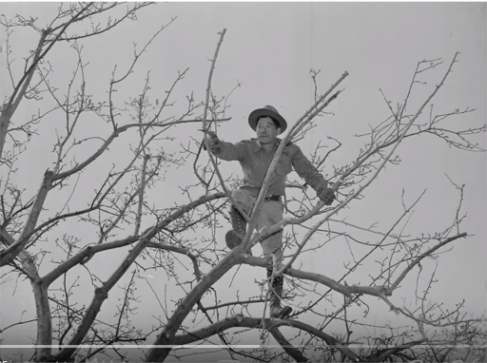
Pruning a Tree

Slide 56
Avoid Overfitting in Classification
The generated tree may overfit the training data
Too many branches, some may reflect anomalies due to noise or outliers
Result in poor accuracy for unseen samples (test data)
Two approaches to avoid overfitting
Prepruning: Halt tree construction early—do not split a node if this would result in the goodness measure falling below a threshold. Difficult to implement
Postpruning: Remove branches from a “fully grown” tree—get a sequence of progressively pruned trees
Use a set of data different from the training data to decide which is the “best pruned tree”
56
Notes:
56

Slide 57
Decision Trees → Decision Forests
Decision Trees are popular because they are easy to understand, explain, or use.
Weakness: They are prone to overfitting.
Decision forests (a generalization of decision trees), where a number of decision trees together form the decision forest, are more successful than DT
Decision forests correct for decision trees' weakness of overfitting to their training set
The decision forest serves as the classifier

Slide 58
End of Lecture 3

Slide 59
Picking a Good Split Feature
Goal is to have the resulting tree be as small as possible
"other things being equal, a simpler explanation is better than a more complex one"
Larger trees are typically less accurate than smaller trees
Occam's razor is the law of parsimony, economy, or succinctness. It is a principle urging one to select from among competing hypotheses that which makes the fewest assumptions.
Top-down divide-and-conquer method does a greedy search for a simple tree but does not guarantee to find the smallest
There are a variety of heuristics. popular one is based on information gain Quinlan (1979).

Slide 60
The simple linear classifier is defined for higher dimensional spaces…

Slide 61
… we can visualize it as being an n-dimensional hyperplane

Slide 62
It is interesting to think about what would happen in this example if we did not have the 3rd dimension…

Slide 63
We can no longer get perfect accuracy with the simple linear classifier…
We could try to solve this problem by user a simple quadratic classifier or a simple cubic classifier..
However, as we will later see, this is probably a bad idea…

Slide 64
Decision Tree Classification
Decision tree
A flow-chart-like tree structure
Internal node denotes a test on an attribute
Branch represents an outcome of the test
Leaf nodes represent class labels or class distribution
Decision tree generation consists of two phases
Tree construction
At start, all the training examples are at the root
Partition examples recursively based on selected attributes
Tree pruning
Identify and remove branches that reflect noise or outliers
Use of decision tree: Classifying an unknown sample
Test the attribute values of the sample against the decision tree

Slide 65
What is a model?
A simplified* representation of reality created for a specific purpose.
Examples: map, blue prints
Data Mining Example (from introduction module):
“formula” for predicting probability of customer attrition at contract expiration
“classification model” or “class-probability estimation
model”
* simplification is based on some assumptions

Slide 66

Iris.xlsx dataset is on the Black Board

Slide 67
Iris Dataset (first few instances) in xls format
Target
Petal_width | Petal_length | Sepal_width | Sepal_length | Species_name
0.2 | 1.4 | 3.5 | 5.1 | Setosa
0.2 | 1.4 | 3 | 4.9 | Setosa
0.2 | 1.3 | 3.2 | 4.7 | Setosa
0.2 | 1.5 | 3.1 | 4.6 | Setosa
0.2 | 1.4 | 3.6 | 5 | Setosa
0.4 | 1.7 | 3.9 | 5.4 | Setosa
0.3 | 1.4 | 3.4 | 4.6 | Setosa
0.2 | 1.5 | 3.4 | 5 | Setosa
0.2 | 1.4 | 2.9 | 4.4 | Setosa
0.1 | 1.5 | 3.1 | 4.9 | Setosa
0.2 | 1.5 | 3.7 | 5.4 | Setosa
0.2 | 1.6 | 3.4 | 4.8 | Setosa
0.1 | 1.4 | 3 | 4.8 | Setosa
0.1 | 1.1 | 3 | 4.3 | Setosa
0.2 | 1.2 | 4 | 5.8 | Setosa
0.4 | 1.5 | 4.4 | 5.7 | Setosa
0.4 | 1.3 | 3.9 | 5.4 | Setosa
0.3 | 1.4 | 3.5 | 5.1 | Setosa
0.3 | 1.7 | 3.8 | 5.7 | Setosa
0.3 | 1.5 | 3.8 | 5.1 | Setosa
0.2 | 1.7 | 3.4 | 5.4 | Setosa
0.4 | 1.5 | 3.7 | 5.1 | Setosa
0.2 | 1 | 3.6 | 4.6 | Setosa
0.5 | 1.7 | 3.3 | 5.1 | Setosa

Slide 68
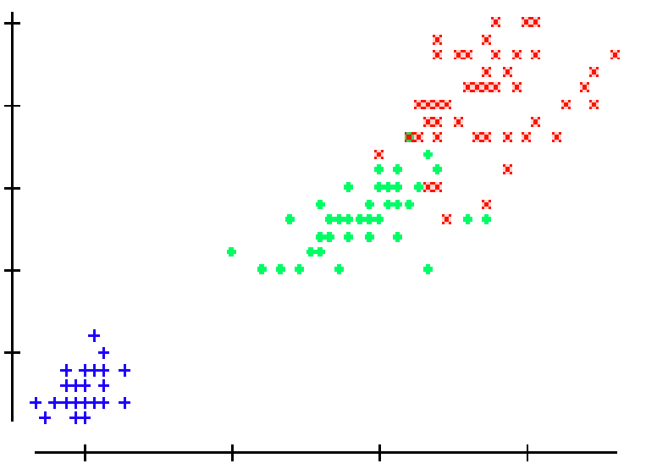
We can generalize the piecewise linear classifier to N classes, by fitting N-1 lines. In this case we first learned the line to (perfectly) discriminate between Setosa and Virginica/Versicolor, then we learned to approximately discriminate between Virginica and Versicolor.
Virginica
Setosa
Versicolor
If petal width > 3.272 – (0.325 * petal length) then class = Virginica
Elseif petal width…

Slide 69
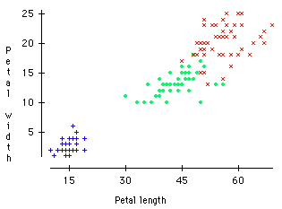
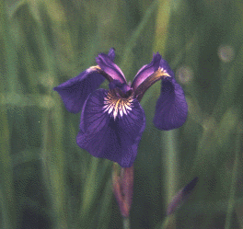
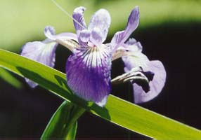
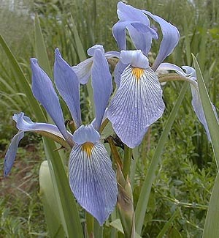
Virginica
A Famous Problem
R. A. Fisher’s Iris Dataset. 1936
3 classes
50 of each class
The task is to classify Iris plants into one of 3 varieties using the Petal Length and Petal Width.
Setosa
Versicolor
Iris Setosa
Iris Versicolor
Iris Virginica

Slide 70
Entropy and Information Gain
Entropy: Lack of Order or Predictability
We will measure entropy before a split and after a split. If entropy is reduced by the split, then we may consider using that split.
We will choose that attribute which has the maximum expected reduction in entropy
Entropy reduction is also called Information Gain

Slide 71
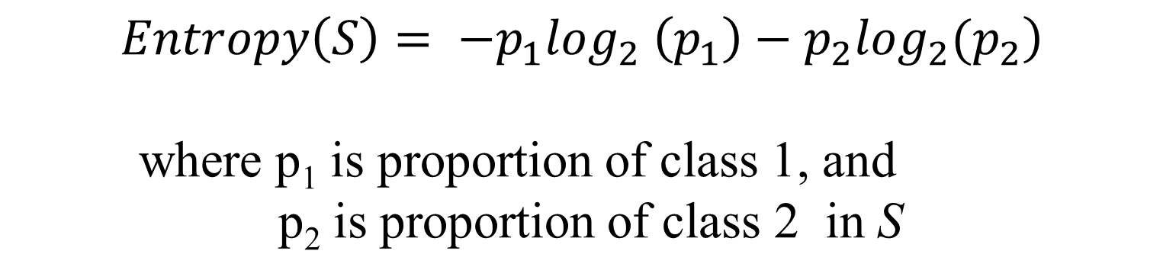
Information Gain as A
Splitting Criteria
Select the attribute with the highest information gain (information gain is the expected reduction in entropy).
Assume there are two classes, P (with p elements) and N (with n elements). The Entropy of the set (S) is
$$\left.Entropy\left(S\right)= −p_{1}\log_{2} \left(p_{1}\right)−p_{2}\log_{2}(p_{2}\right)$$
where p₁ is proportion of class 1, and
p₂ is proportion of class 2 in S
0 log(0) is defined as 0

